Slide 1
Demand Forecasting for E-commerce
\
By Gopalakrishnan Kumar, MTech IIT-Bombay,
Freelance Data Science Consultant
LinkedIn: Profile Link : https://www.linkedin.com/in/gopalakrishnankumar-a73301110/
Github:https://www.github.com/Gopalakrishnan-Kumar/
Kaggle URL- https://www.kaggle.com/gopalkk2

Slide 2
Google Colab URL
https://colab.research.google.com/drive/17b6IT1mD9sHl_31AmJc9NiDp37NEoMrF?usp=sharing

Slide 3
Introduction
E-commerce businesses rely heavily on accurate demand forecasting to manage inventory, optimize supply chain, and meet customer expectations. Sudden demand spikes during festive seasons or unpredicted drops in certain months can lead to overstocking, understocking, or revenue loss.
This project demonstrates time series forecasting of monthly product demand using a synthetic dataset. Various visualization techniques are applied to identify trends, seasonality, and patterns before moving into predictive modeling such as ARIMA.

Slide 4
Dataset Description
Dataset name: ecommerce_demand.csv
Duration: Multiple years of monthly records (e.g., 2018–2023)
Columns:
Month → Monthly timestamp
Demand → Units demanded per month
The dataset captures gradual growth trend and strong seasonal spikes,
particularly in November and December due to holiday shopping.

Slide 5
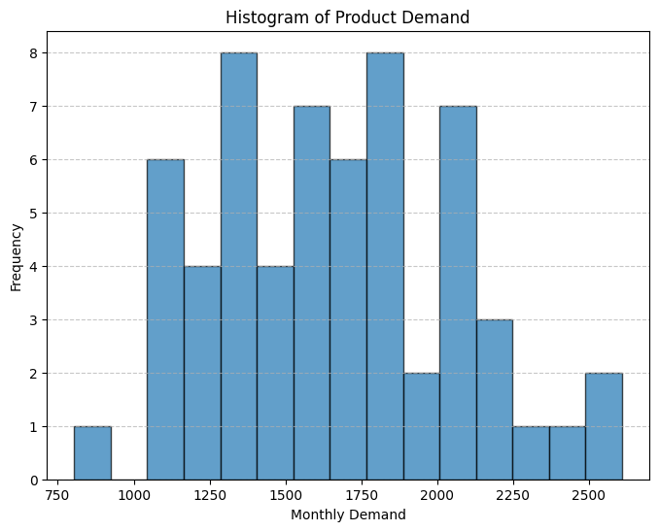
Data Visualization

Slide 6
Exploratory Data Analysis (EDA)
3.1 Histogram of Demand
A histogram was plotted to show the distribution of demand values.
The distribution shows skewness towards higher values, indicating demand has been increasing over time.
Seasonal peaks (Nov–Dec) appear as outliers on the higher end of the distribution.
📌 Insight: Demand is not normally distributed; instead, it follows an increasing trend with seasonal jumps.

Slide 7
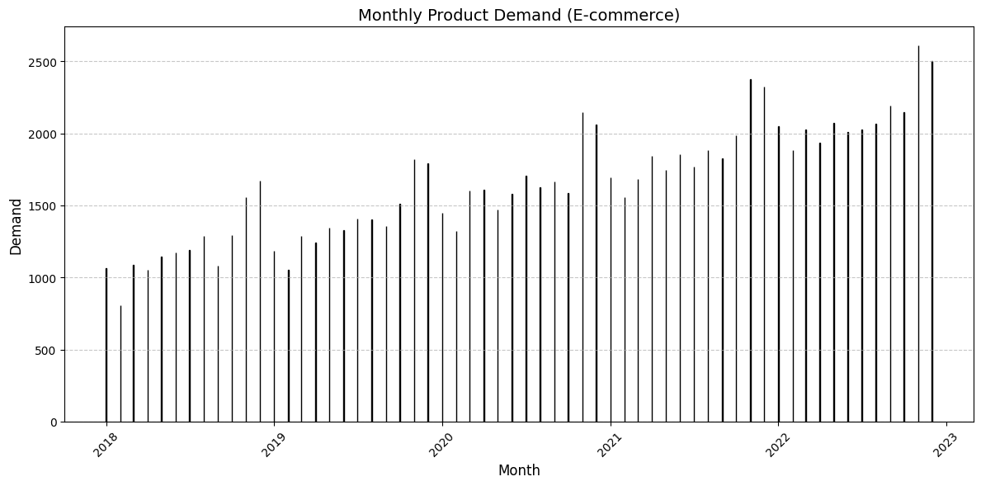
Data Visualization

Slide 8
Exploratory Data Analysis (EDA)
3.2 Bar Chart of Monthly Demand
A bar chart was created with Month on the X-axis and Demand on the Y-axis.
Clear fluctuations month by month were observed.
Consistent peaks in Nov and Dec show the strong influence of
holiday sales season.
Gradual upward slope confirms year-over-year demand growth.
📌 Insight: The retail cycle heavily impacts demand,
with holiday periods contributing disproportionately.

Slide 9
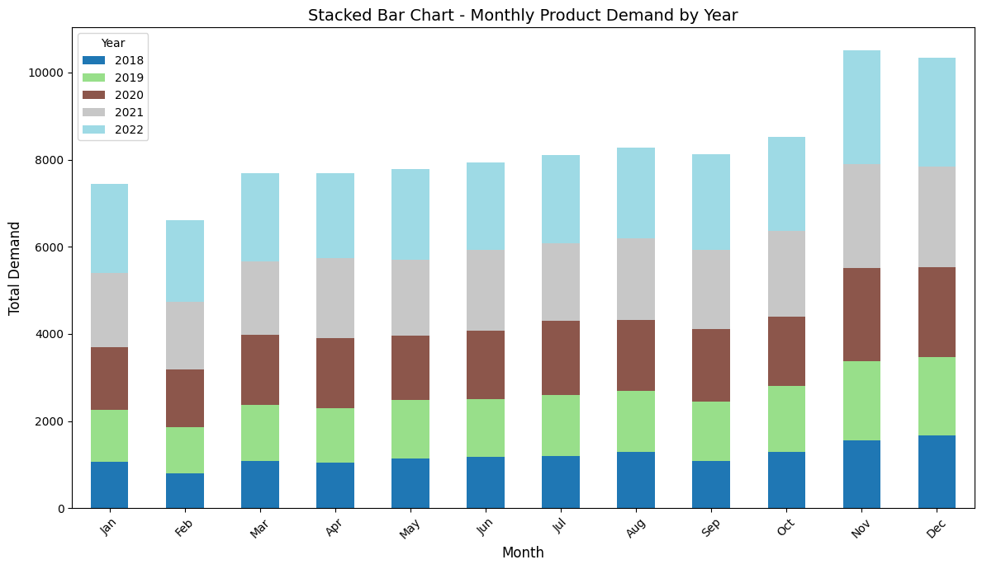
Data Visualization

Slide 10
Exploratory Data Analysis (EDA)
3.3 Stacked Bar Chart (Month vs Year)
A stacked bar chart was plotted where each month is represented by a bar stacked with contributions from different years.
This visualization highlights how each year’s demand adds up for the same month across multiple years.
Nov–Dec consistently have higher stacked bars, showing multi-year growth during holidays.
📌 Insight: Not only is demand seasonal, but it is getting stronger each year.

Slide 11

Data Visualization

Slide 12
Exploratory Data Analysis (EDA)
3.4 Combined Stacked Bar Chart
In this chart, months are grouped on the X-axis, while within each month, demand is stacked by year.
This gives a clearer picture of how yearly contributions compare month by month.
For example, demand in July is relatively stable, while demand in December shows steep growth year-on-year.
📌 Insight: Demand growth is not uniform across months. The holiday season accelerates more sharply compared to regular months.

Slide 13
Business Implications
Inventory Planning: Businesses must prepare additional stock for Nov–Dec, sometimes 2–3x
the average monthly demand.
Staff Allocation: Workforce requirements should be scaled up during festive months to handle
higher order volumes.
Marketing Strategy: Targeted marketing in Q4 (Oct–Dec) can maximize sales during peak demand.
Supplier Management: Long-term supplier contracts should account for seasonal variations
to avoid delays.

Slide 14
Next Steps – Forecasting
Based on the exploratory analysis, we can move forward with:
ARIMA/SARIMA Modeling – To capture trend + seasonality.
Machine Learning Models (XGBoost, LSTM) – To enhance accuracy.
Scenario Analysis – Predict demand under scenarios like promotions, economic shifts, or new competitors.

Slide 15
Conclusion
This project highlights how visualization and forecasting of demand can provide actionable insights for e-commerce businesses.
Demand is increasing year-over-year.
Nov–Dec spikes dominate overall sales, confirming the importance of holiday shopping events.
A forecasting model will enable better inventory control, reduced losses, and optimized operations.

